Slide 1
Exponential Functions: Optimization Word Problems

Slide 2
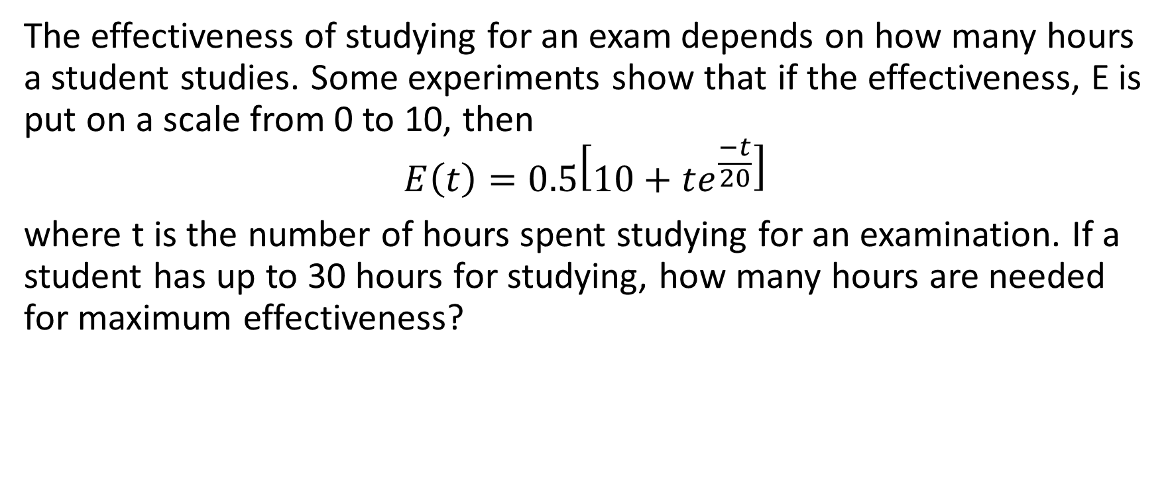
Example 1
The effectiveness of studying for an exam depends on how many hours a student studies. Some experiments show that if the effectiveness, E is put on a scale from 0 to 10, then
$$E\left(t\right)=0.5\left[10+te^{\frac{−t}{20}}\right]$$
where t is the number of hours spent studying for an examination. If a student has up to 30 hours for studying, how many hours are needed for maximum effectiveness?

Slide 3
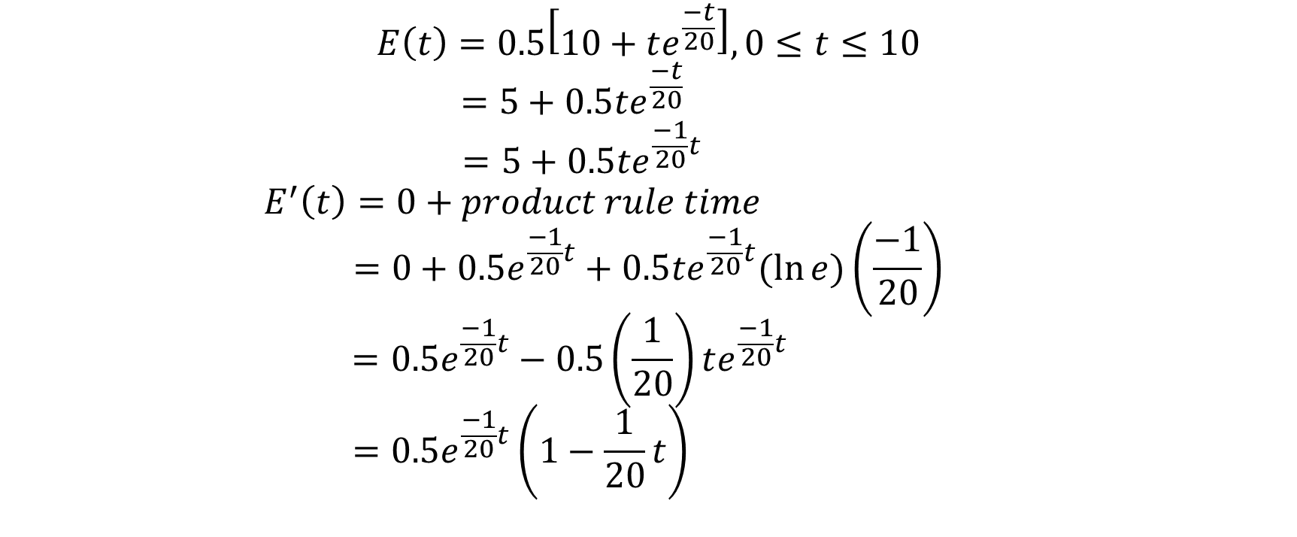
$$E\left(t\right)=0.5\left[10+te^{\frac{−t}{20}}\right],0≤t≤10$$
$$=5+0.5te^{\frac{−t}{20} }$$
$$=5+0.5te^{\frac{−1}{20}t}$$
$$E^{′}\left(t\right)=0+product rule time$$
$$=0+0.5e^{\frac{−1}{20}t}+0.5te^{\frac{−1}{20}t}(\ln{e)\left(\frac{−1}{20}\right)}$$
$$=0.5e^{\frac{−1}{20}t}−0.5\left(\frac{1}{20}\right)te^{\frac{−1}{20}t}$$
$$=0.5e^{\frac{−1}{20}t}\left(1−\frac{1}{20}t\right)$$

Slide 4
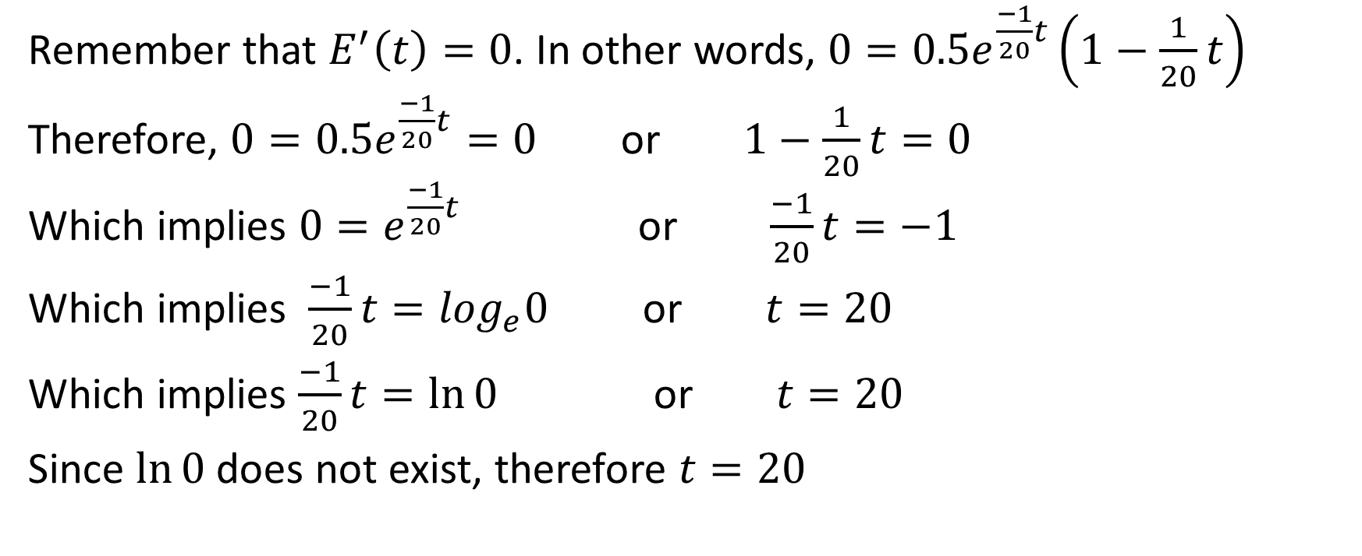
Remember that $E^{′}\left(t\right)=0$. In other words, $0=0.5e^{\frac{−1}{20}t}\left(1−\frac{1}{20}t\right)$
Therefore, $0=0.5e^{\frac{−1}{20}t}=0$ or $1−\frac{1}{20}t=0$
Which implies $0=e^{\frac{−1}{20}t}$ or $\frac{−1}{20}t=−1$
Which implies $\frac{−1}{20}t=\log_{e}0$ or $t=20$
Which implies $\frac{−1}{20}t=\ln{0}$ or $t=20$
Since $\ln{0}$ does not exist, therefore $t=20$

Slide 5
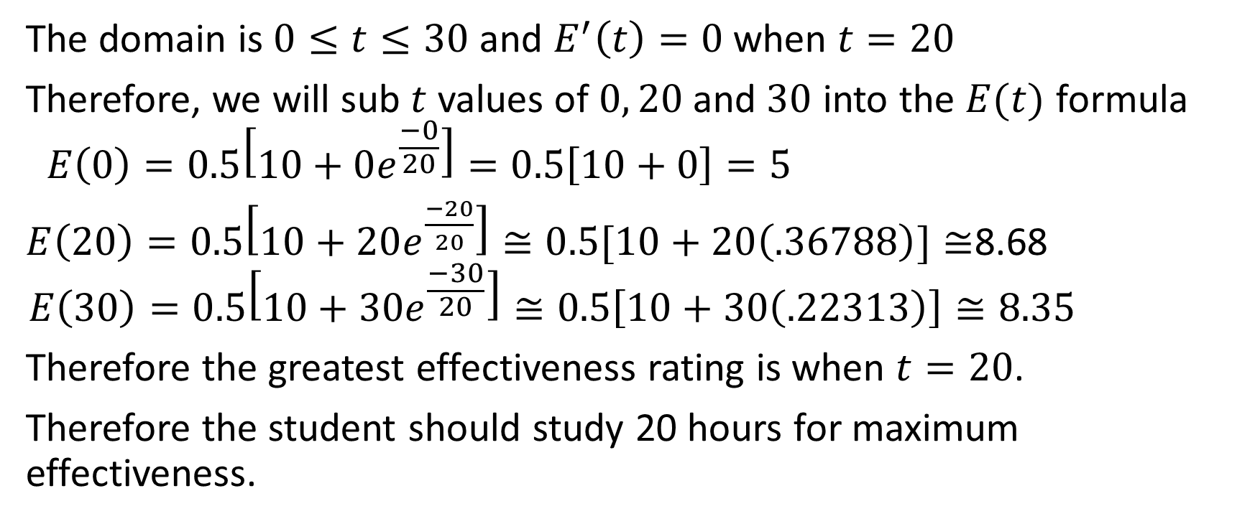
The domain is $0≤t≤30$ and $E^{′}\left(t\right)=0$when $t=20$
Therefore, we will sub $t$ values of $0, 20$and $30$ into the $E(t)$ formula
$$E\left(0\right)=0.5\left[10+0e^{\frac{−0}{20}}\right]=0.5\left[10+0\right]=5$$
$E\left(20\right)=0.5\left[10+20e^{\frac{−20}{20}}\right]≅0.5[10+20\left(.36788\right)]≅$8.68
$$E\left(30\right)=0.5\left[10+30e^{\frac{−30}{20}}\right]≅0.5\left[10+30\left(.22313\right)\right]≅8.35$$
Therefore the greatest effectiveness rating is when $t=20$.
Therefore the student should study 20 hours for maximum effectiveness.

Slide 6
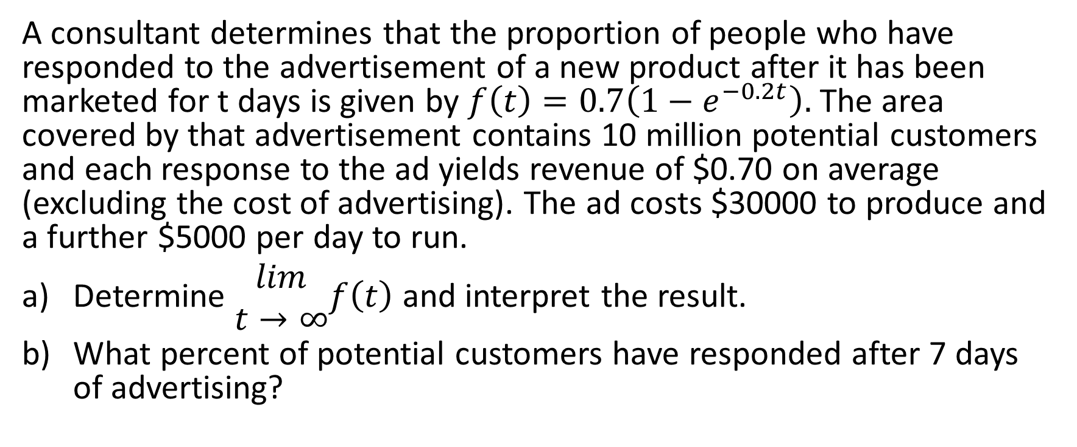
Example 2
A consultant determines that the proportion of people who have responded to the advertisement of a new product after it has been marketed for t days is given by $f\left(t\right)=0.7\left(1−e^{−0.2t}\right).$ The area covered by that advertisement contains 10 million potential customers and each response to the ad yields revenue of $0.70 on average (excluding the cost of advertising). The ad costs $30000 to produce and a further $5000 per day to run.
Determine $\begin{matrix}lim \\ t→∞\end{matrix}f\left(t\right)$ and interpret the result.
What percent of potential customers have responded after 7 days of advertising?

Slide 7
c) Write the function P(t) that represents the average profit after t days of advertising. What is the average profit after 7 days?
d) For how many full days should the ad campaign be run in order to maximize the average profit? Assume an advertising budget of $200000.

Slide 8
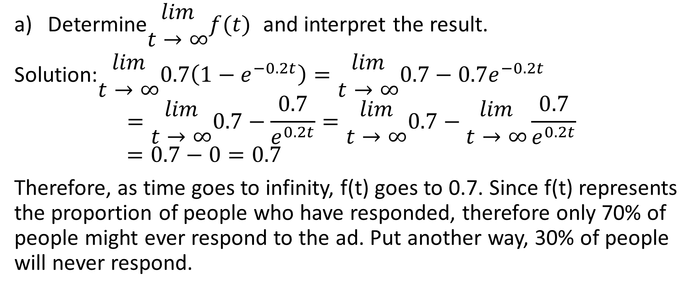
Determine$\begin{matrix}lim \\ t→∞\end{matrix}f(t)$ and interpret the result.
Solution:$\begin{matrix}lim \\ t→∞\end{matrix}0.7\left(1−e^{−0.2t}\right)=\begin{matrix}lim \\ t→∞\end{matrix}0.7−0.7e^{−0.2t}$
$$=\begin{matrix}lim \\ t→∞\end{matrix}0.7−\frac{0.7}{e^{0.2t}}=\begin{matrix}lim \\ t→∞\end{matrix}0.7−\begin{matrix}lim \\ t→∞\end{matrix}\frac{0.7}{e^{0.2t}}$$
$$=0.7−0=0.7$$
Therefore, as time goes to infinity, f(t) goes to 0.7. Since f(t) represents the proportion of people who have responded, therefore only 70% of people might ever respond to the ad. Put another way, 30% of people will never respond.

Slide 9
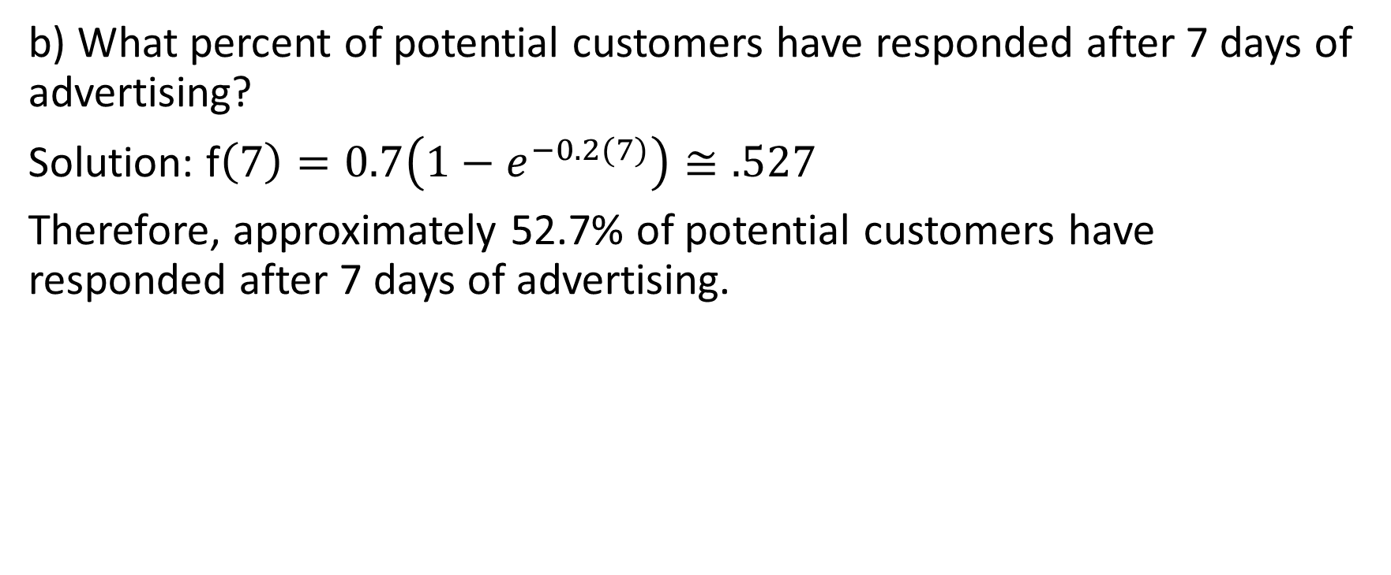
b) What percent of potential customers have responded after 7 days of advertising?
Solution: f$\left(7\right)=0.7\left(1−e^{−0.2(7)}\right)≅.527$
Therefore, approximately 52.7% of potential customers have responded after 7 days of advertising.

Slide 10
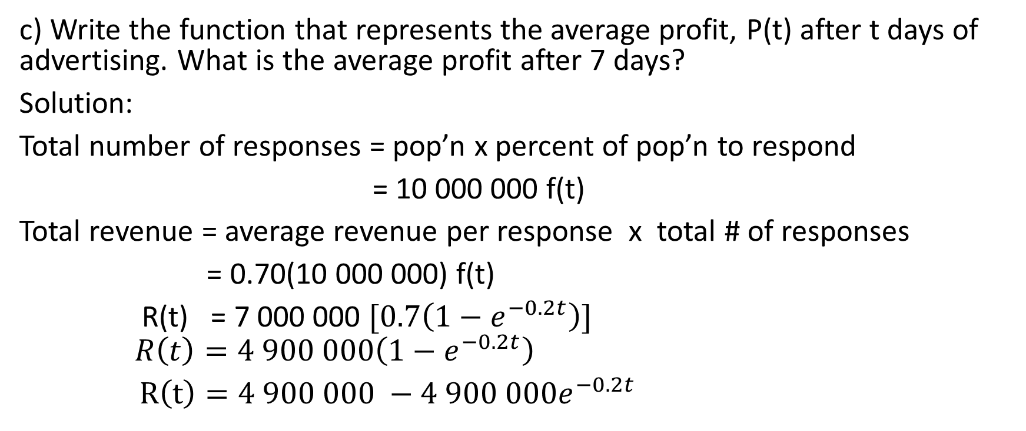
c) Write the function that represents the average profit, P(t) after t days of advertising. What is the average profit after 7 days?
Solution:
Total number of responses = pop’n x percent of pop’n to respond
= 10 000 000 f(t)
Total revenue = average revenue per response x total # of responses
= 0.70(10 000 000) f(t)
R(t) = 7 000 000 $[0.7\left(1−e^{−0.2t}\right)]$
$$R\left(t\right)=4 900 000\left(1−e^{−0.2t}\right)$$
$R\left(t\right)=4 900 000 −4 900 000e^{−0.2t}$

Slide 11
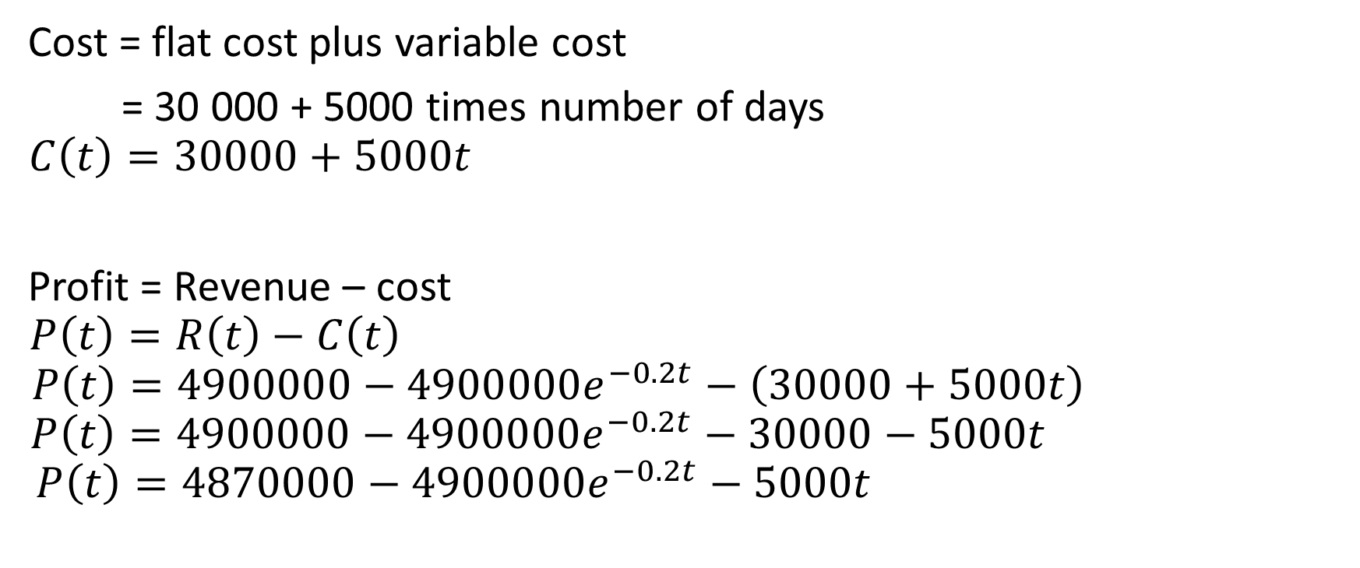
Cost = flat cost plus variable cost
= 30 000 + 5000 times number of days
$$C\left(t\right)=30000+5000t$$
Profit = Revenue – cost
$$P\left(t\right)=R\left(t\right)−C\left(t\right)$$
$$P\left(t\right)=4900000−4900000e^{−0.2t}−\left(30000+5000t\right)$$
$$P\left(t\right)=4900000−4900000e^{−0.2t}−30000−5000t$$
$$P\left(t\right)=4870000−4900000e^{−0.2t}−5000t$$

Slide 12

$$P\left(7\right)=4870000−4900000e^{−0.2\left(7\right)}−5000\left(7\right)$$
≈ 3 626 674.88
Therefore the profit after 7 days is approximately $ 3 626 674.88

Slide 13
d) For how many full days should the advertising campaign be run in order to maximize the average profit? Assume an advertising budget of $200 000.
Solution: We know that the minimum number of days that the ad campaign can run is 0. To determine the maximum number of days, we see that the total cost must be ≤ 200 000
30 000 + 5000t ≤ 200 000
5000t ≤ 170 000
t ≤ 34 Therefore the domain is 0 ≤ t ≤ 34

Slide 14
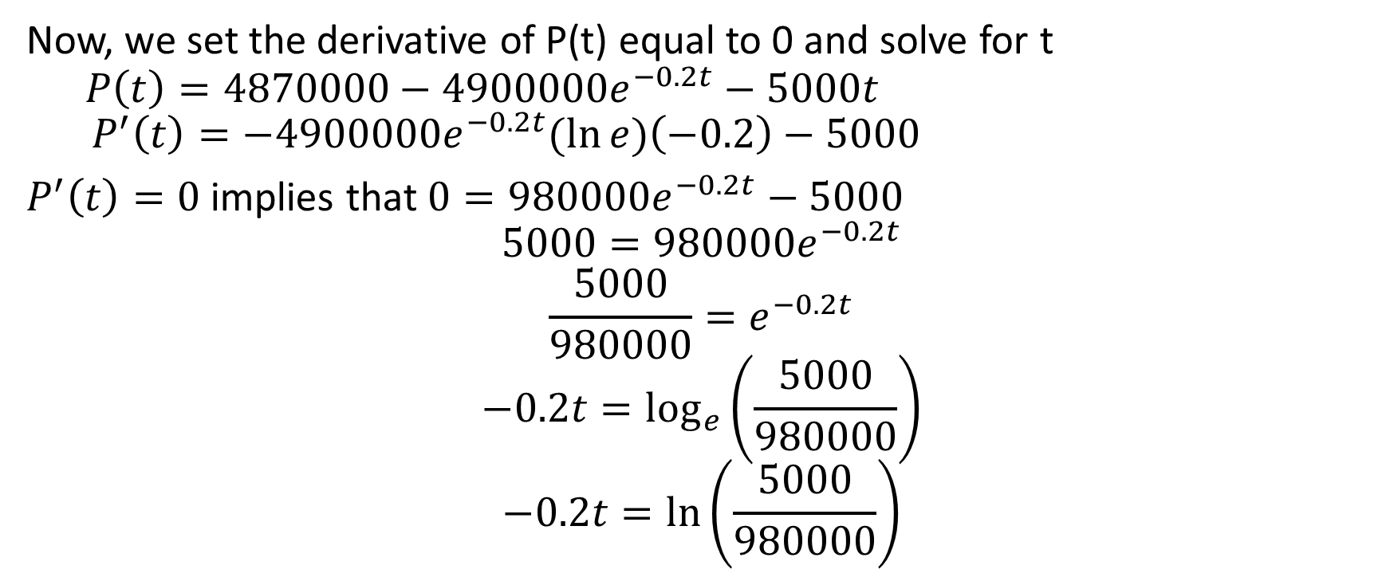
Now, we set the derivative of P(t) equal to 0 and solve for t
$$P\left(t\right)=4870000−4900000e^{−0.2t}−5000t$$
$$P^{′}\left(t\right)=−4900000e^{−0.2t}(\ln{e)\left(−0.2\right)−5000 }$$
$P^{′}\left(t\right)=0$ implies that $0=980000e^{−0.2t}−5000$
$$5000=980000e^{−0.2t}$$
$$\frac{5000}{980000}=e^{−0.2t}$$
$$−0.2t=\log_{e}\left(\frac{5000}{980000}\right)$$
$$−0.2t=\ln\left(\frac{5000}{980000}\right)$$

Slide 15
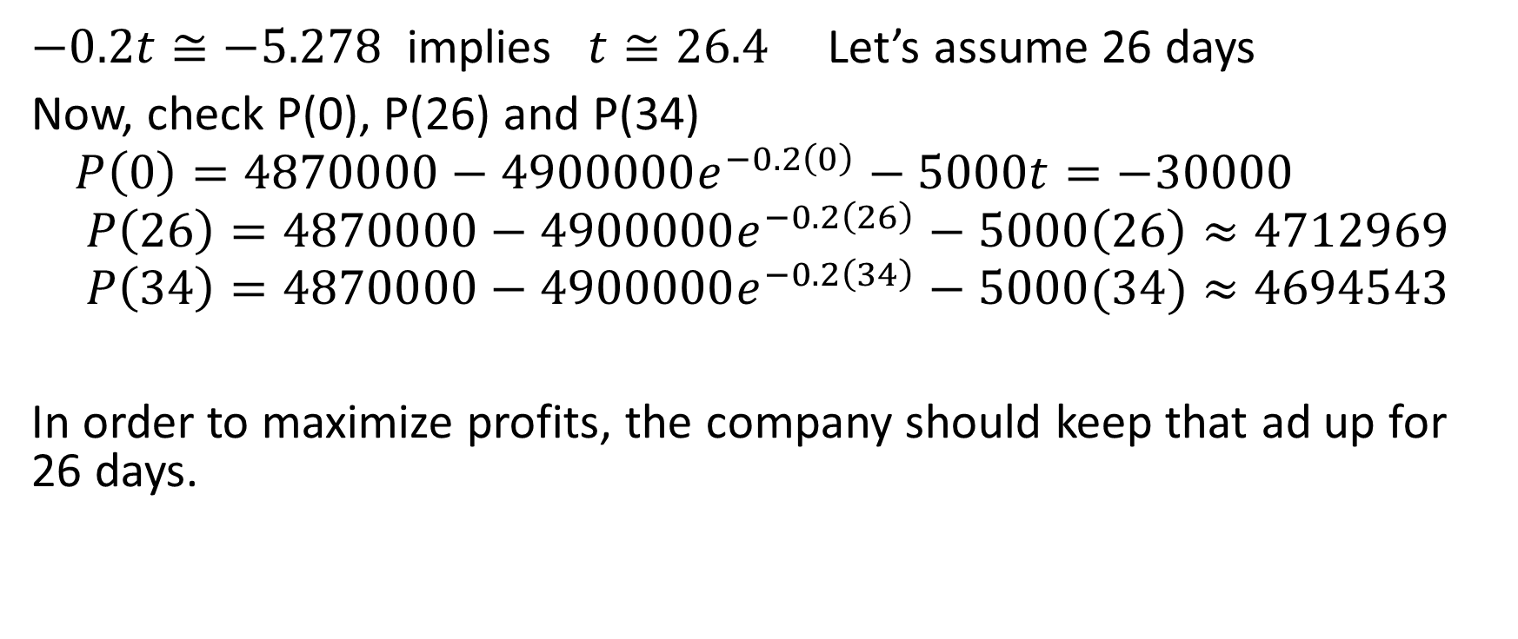
$−0.2t≅−5.278$ implies $t≅26.4$ Let’s assume 26 days
Now, check P(0), P(26) and P(34)
$$P\left(0\right)=4870000−4900000e^{−0.2\left(0\right)}−5000t=−30000$$
$$P\left(26\right)=4870000−4900000e^{−0.2\left(26\right)}−5000\left(26\right)≈4712969$$
$$P\left(34\right)=4870000−4900000e^{−0.2\left(34\right)}−5000(34)≈4694543$$
In order to maximize profits, the company should keep that ad up for 26 days.

